Slide 1
LIBRARY MANAGEMENT SYSTEM
A city library maintains information about its branches, employees, customers, and books.
Each branch has a manager and contact details. Employees work in different branches with specific roles and salaries.
Customers register to borrow books, and books are categorized with rental prices and availability status.

Slide 2
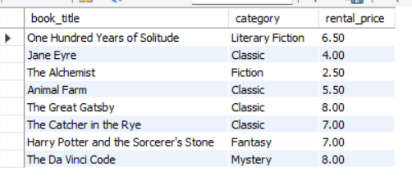
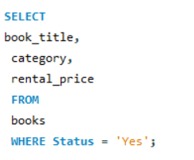
1.Display all available books for rent
Input
Output

Slide 3
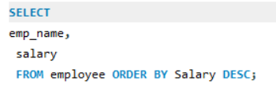
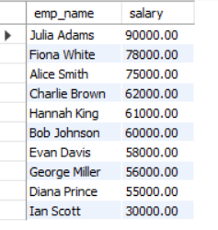
2.List employees in descending order of salary
Input
Output

Slide 4
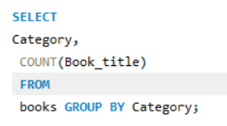
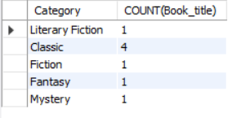
3. Count number of books in each category
Input
Output

Slide 5
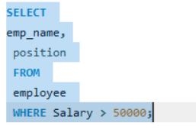
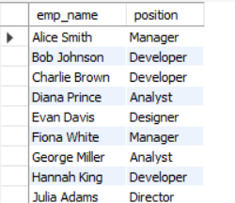
4. Find employees earning more than ₹50,000
Input
Output

Slide 6
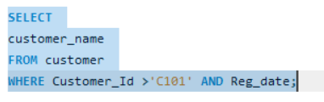
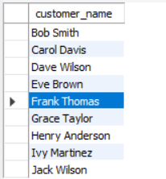
5.Display customers registered customer_id before C101
Input
Output

Slide 7
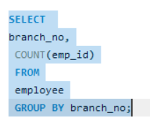
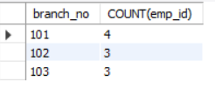
6. Count number of employees working in each branch
Input
Output

Slide 8
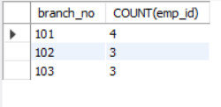
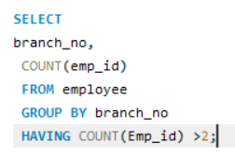
7. Find branches having more than 2 employees
Output
Input

Slide 9
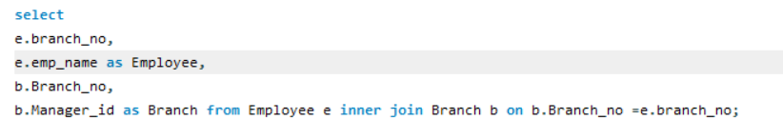
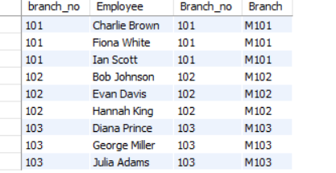
8. Display employee name with their branch manager (INNER JOIN)
Input
Output

Slide 10
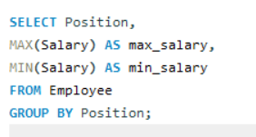
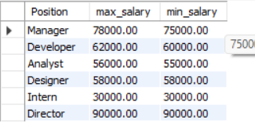
9. Find maximum and minimum salary by job position
Input
Output

Slide 11
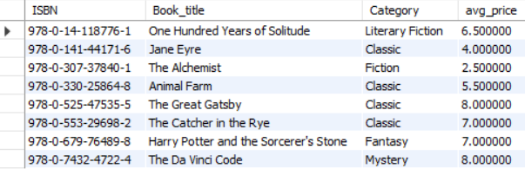
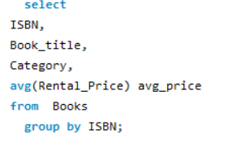
10. Calculate average rental price of books by category
Input
Output

Slide 12
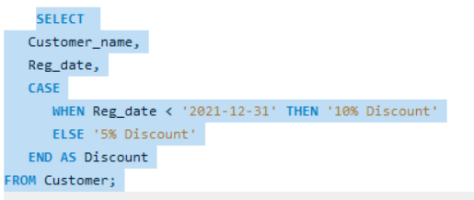
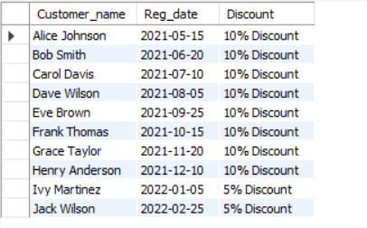
11. Assign discount to customers based on registration date
Input
Output

Slide 13
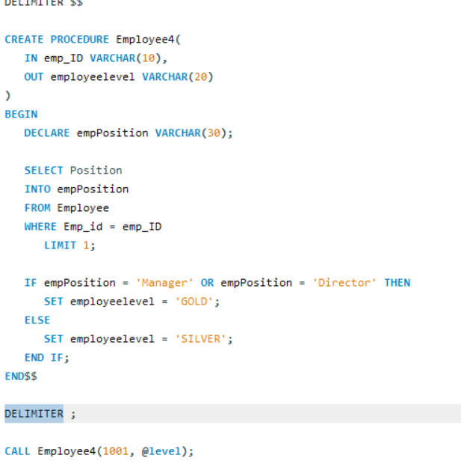

12. Stored Procedure Scenario
Input
Output
SELECT @level;

Slide 14
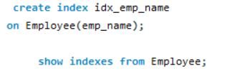
13. Create an index on employee name to speed up searches
Input
Output

Slide 15
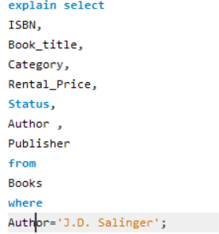
14.Expain Author in J.D.Salinger
Input
Output

Slide 16
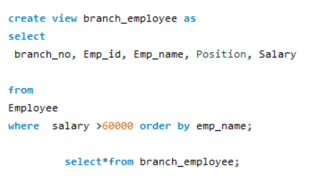
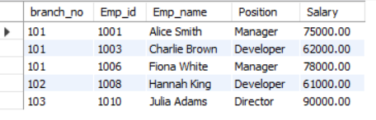
15. Create a VIEW for high-salary employees
Input
Output

Slide 17
CONCLUSION
This scenario covers:
DDL (CREATE, DROP)
DML (INSERT, SELECT)
JOINS
AGGREGATE FUNCTIONS
GROUP BY & HAVING
CASE
VIEW
INDEX
STORED PROCEDURE
Perfect for DBMS lab, practical exam, viva, or mini-project

Slide 18


